Slide 1
Business Introduction
Rally Motors, Inc. is an American automotive that design, manufactures, and sells electric cars.
It has base across North America, Europe and Asia.
There are two phases in the workflow of Rally
Purchasing and delivery phase
Service Phase

Slide 2
Purchasing and delivery phase
From Customer Site
Whenever Customer wants to buy car from Rally, he can order it by two ways.
1. Online
2. Offline (By directly approaching to showroom)
From Company Site
First the order number is going to generate for online customer and offline customer in showroom. Then the order is going to check in the store through showroom weather it is available or not. If the order is available in store, then it can directly transport to the showroom else the order request Will be transferred to the manufacturing department i.e. warehouse.
The store will request the manufacturing unit based on some condition.
Location of store and manufacturing unit.
The order is single unit or there is multiple numbers of units that need to manufacture.
Time restrictions are there between store and manufacturing unit.

Slide 3
Service Phase
After buying the vehicle if customer is facing any issue, customer can contact the service center for took care of that issue. Then we can check whether the vehicle is operable or not. After moving vehicle to service center issue can be resolved.
There is a case in this part:
Is the damaged part need a replacement or not
If yes, then we can follow again the showroom → store → warehouse
If no, then we that resolve the problem right away

Slide 4
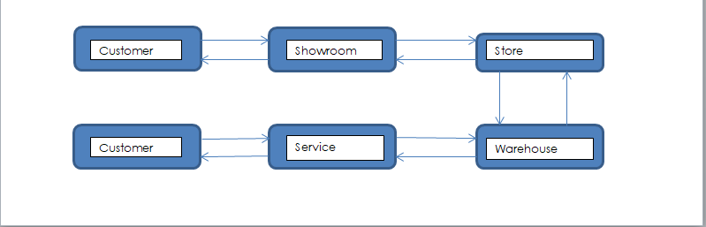
Business Flow Diagram

Slide 5
Pain Points
Address the Service duration delay.
Track the performance of Service Centers and provide best customer service (Customer Satisfaction)
Identify repeated Symptoms to do a permanent fix.

Slide 6
Source System Analysis
Things that can be analyze from source data is contained in this document

Slide 7
Source To Target Mapping

Slide 8
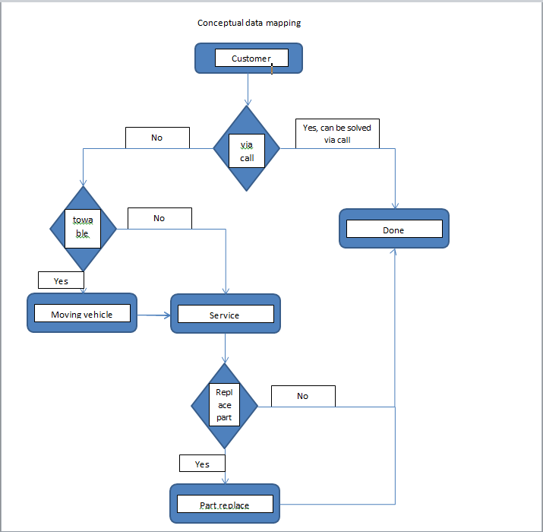
Conceptual Data Modeling

Slide 9
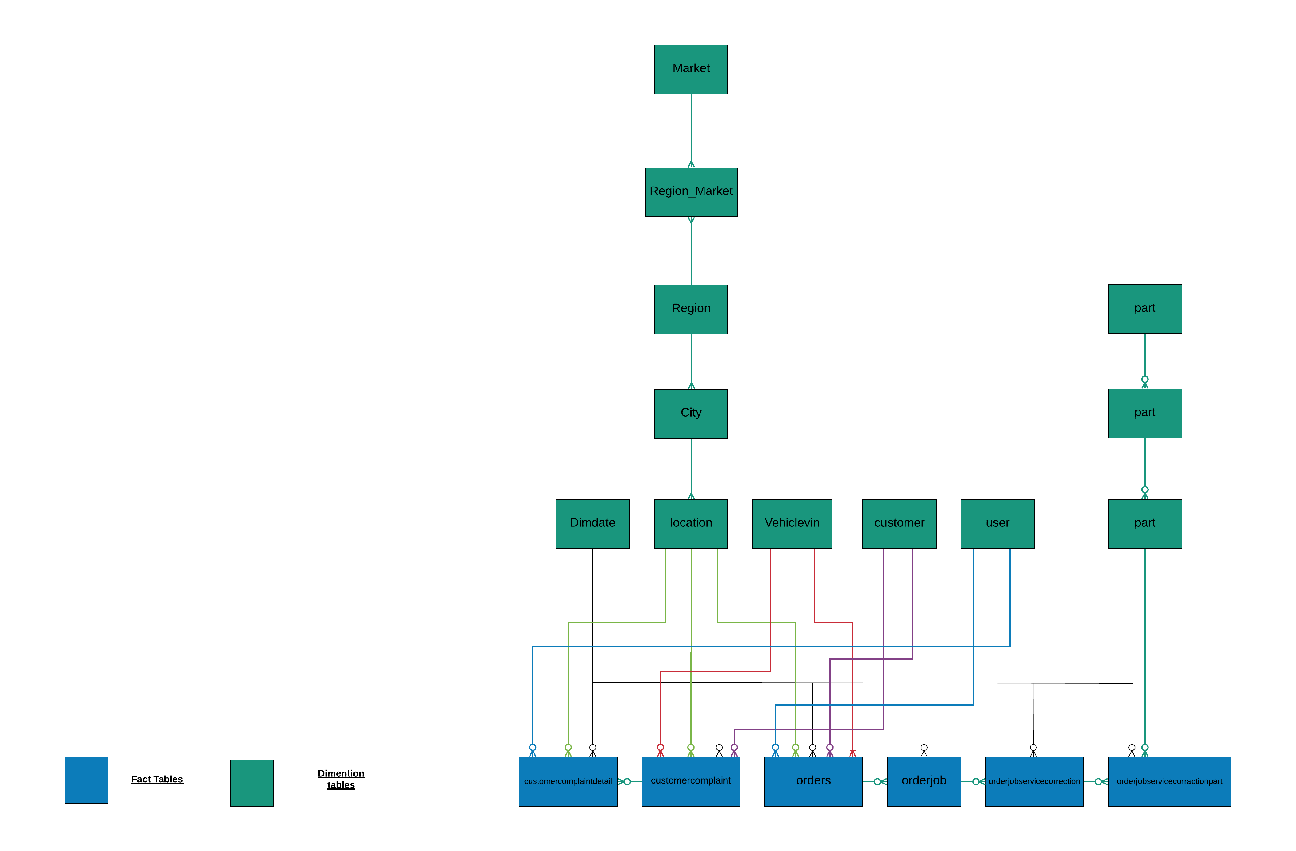
Logical Data Modeling

Slide 10
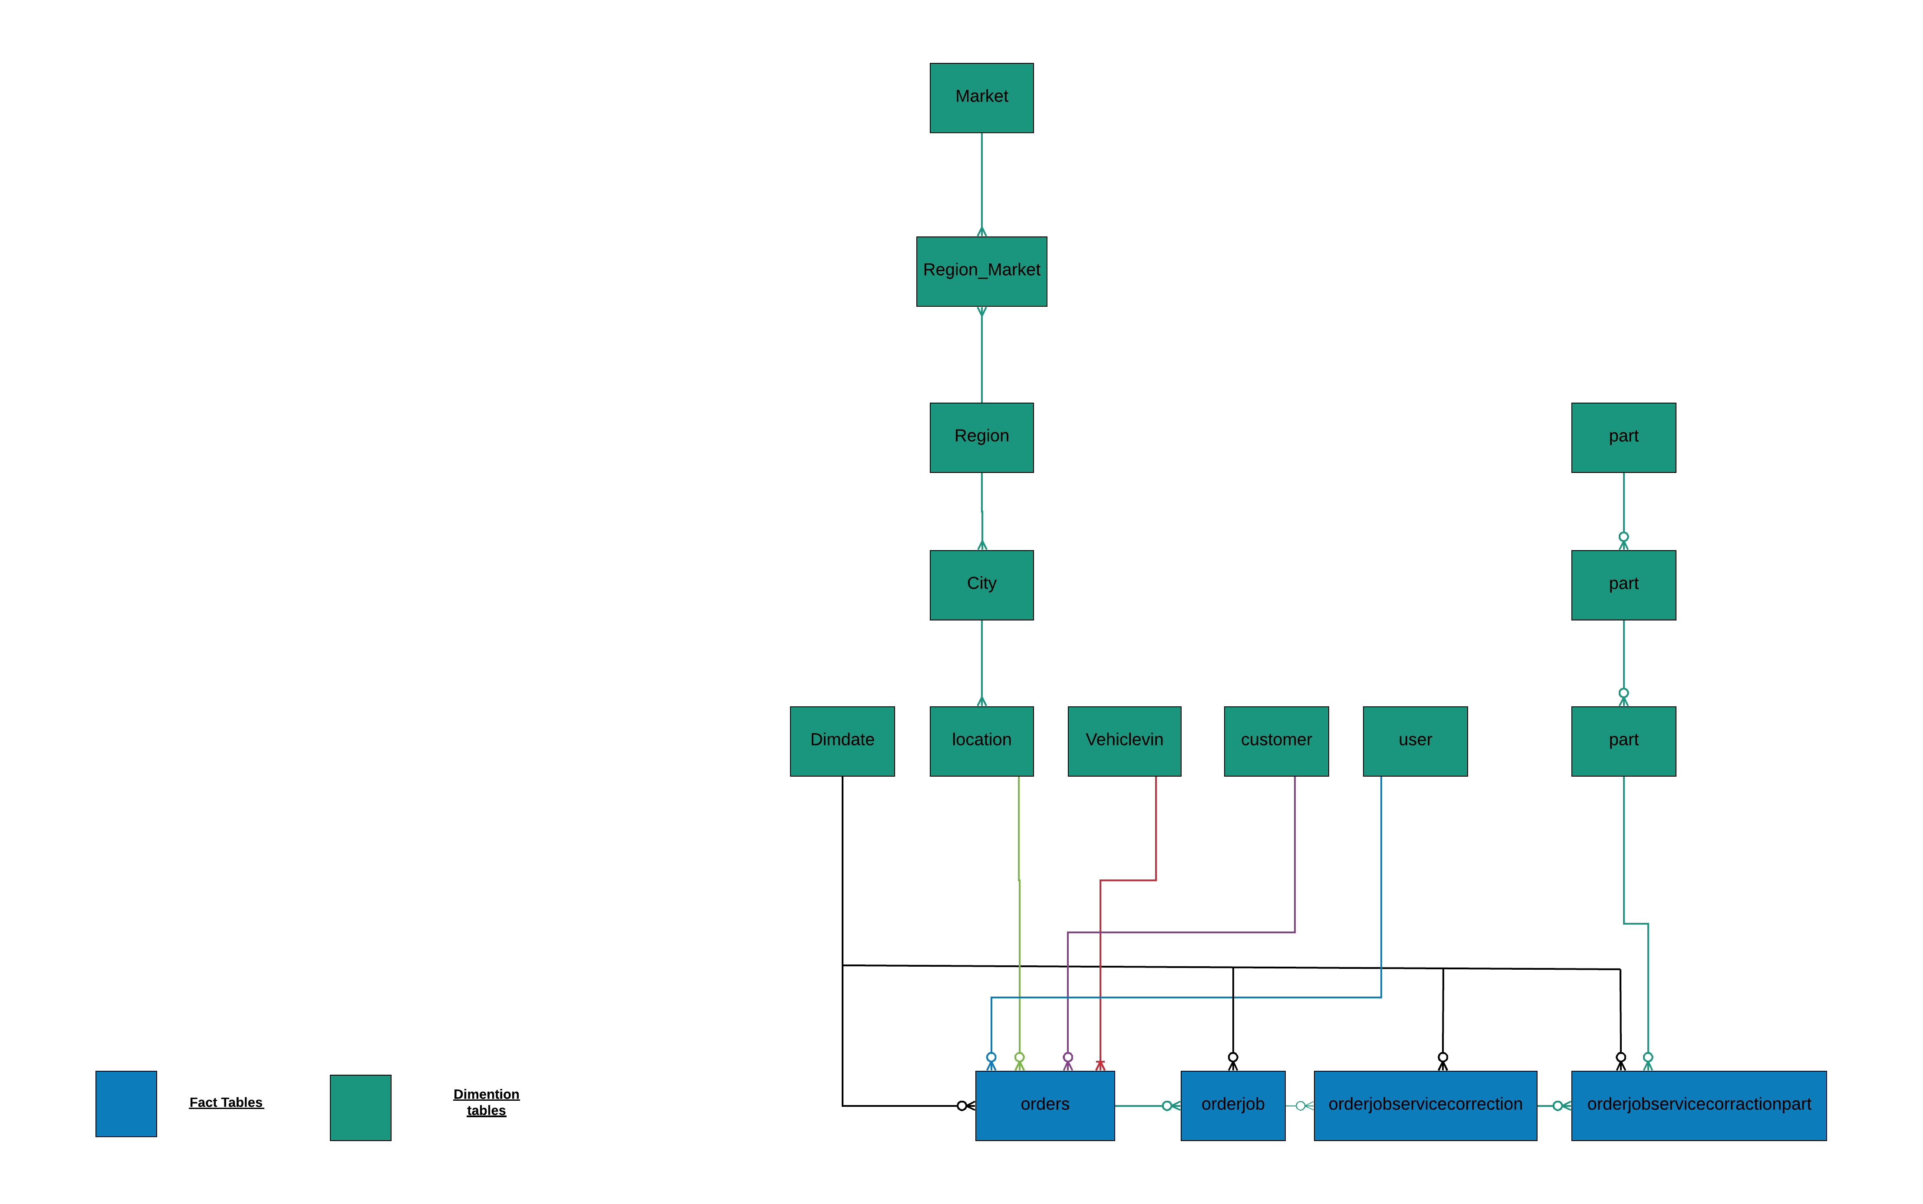
Logical Data Modeling

Slide 11
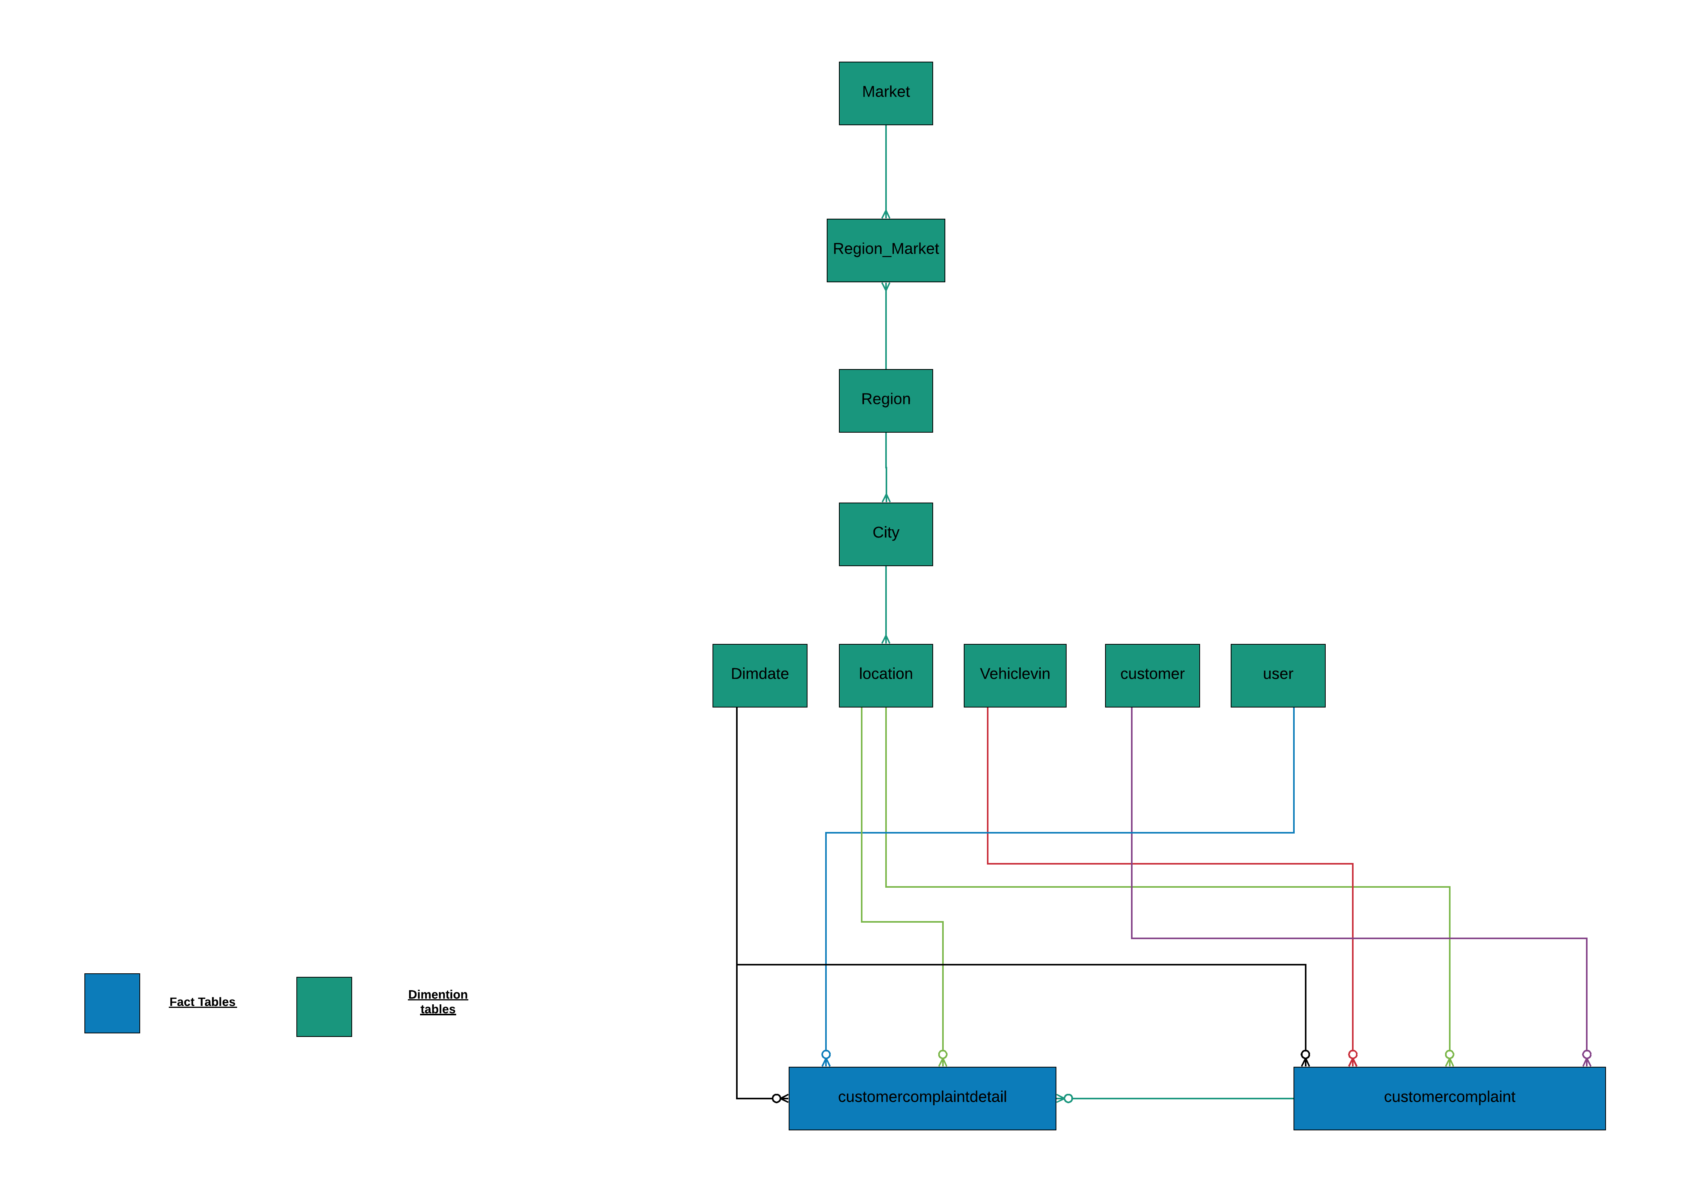
Logical Data Modeling

Slide 12
Physical Data Modeling

Slide 13
BUS Matrix
DATA MART | CUSTOMER | PART | LOCATION | USER | VEHICLEVIN
SERVICE_DATAMART | X | X | X | X | X

Slide 14
ETL STRATEGY
DATABASE
TRANSFORMATION AND JOIN BY SQL
DATABASE
SQL
DATABASE
TRANSFORMATION AND JOIN BY ETL
DATABASE
ETL

Slide 15
SQL QURIES
Fact Table
Dimension Table

Slide 16
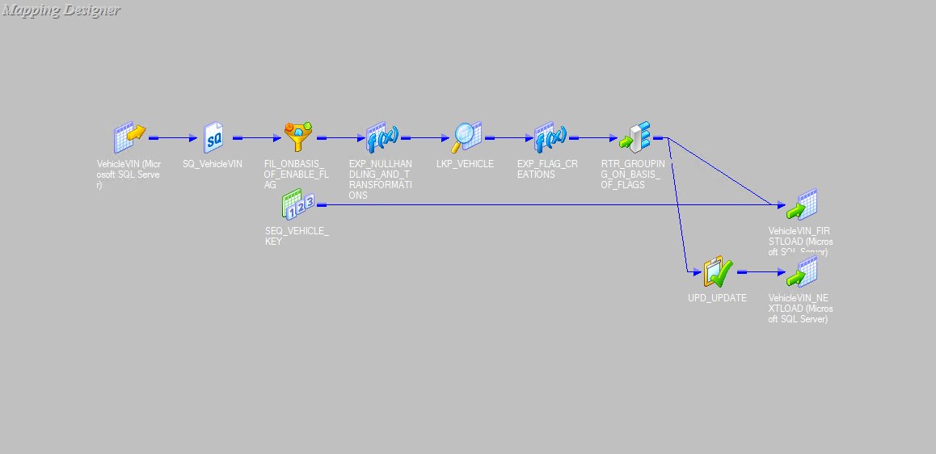
ETL LOAD SCD2(Vehiclevin)

Slide 17
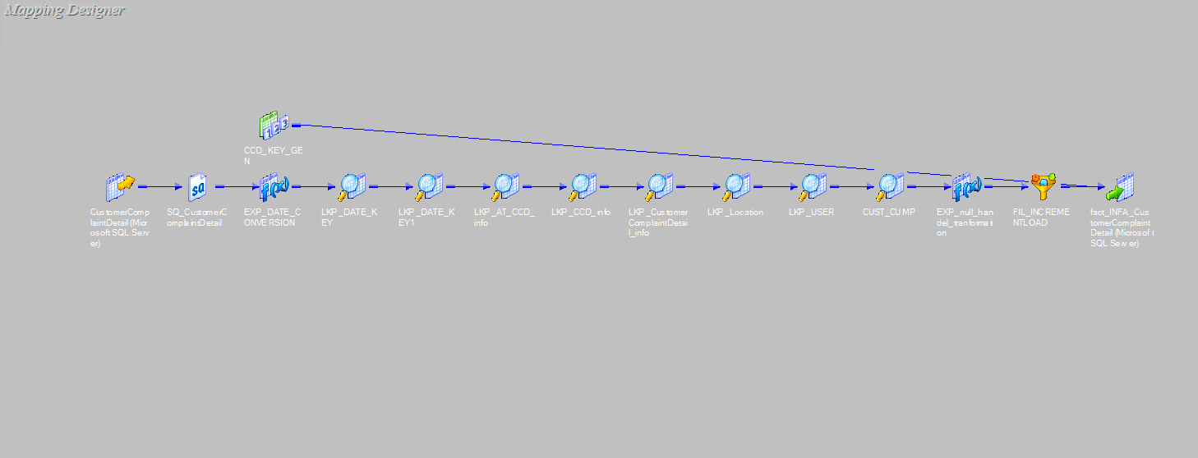
INCREMENT LOAD (Customercomplaintdetail)

Slide 18
ETL TESTING

Slide 19
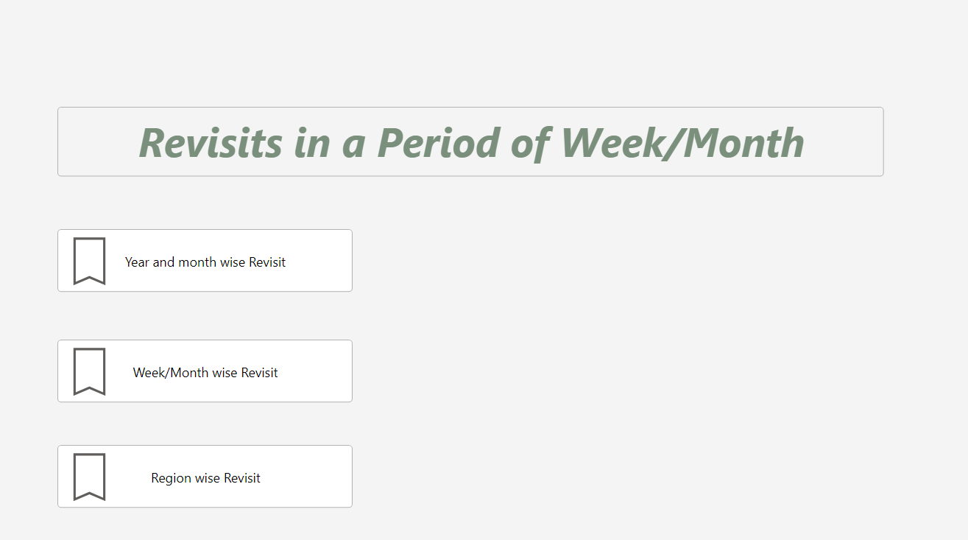
Report Screenshots

Slide 20
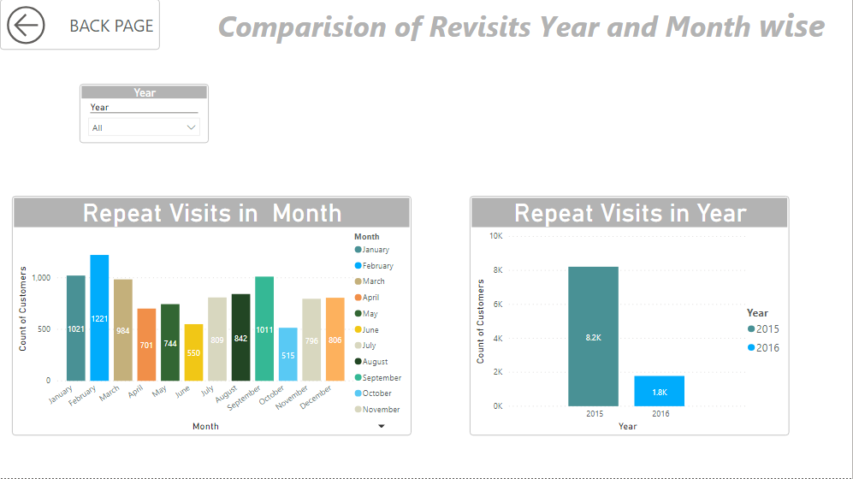
Report

Slide 21
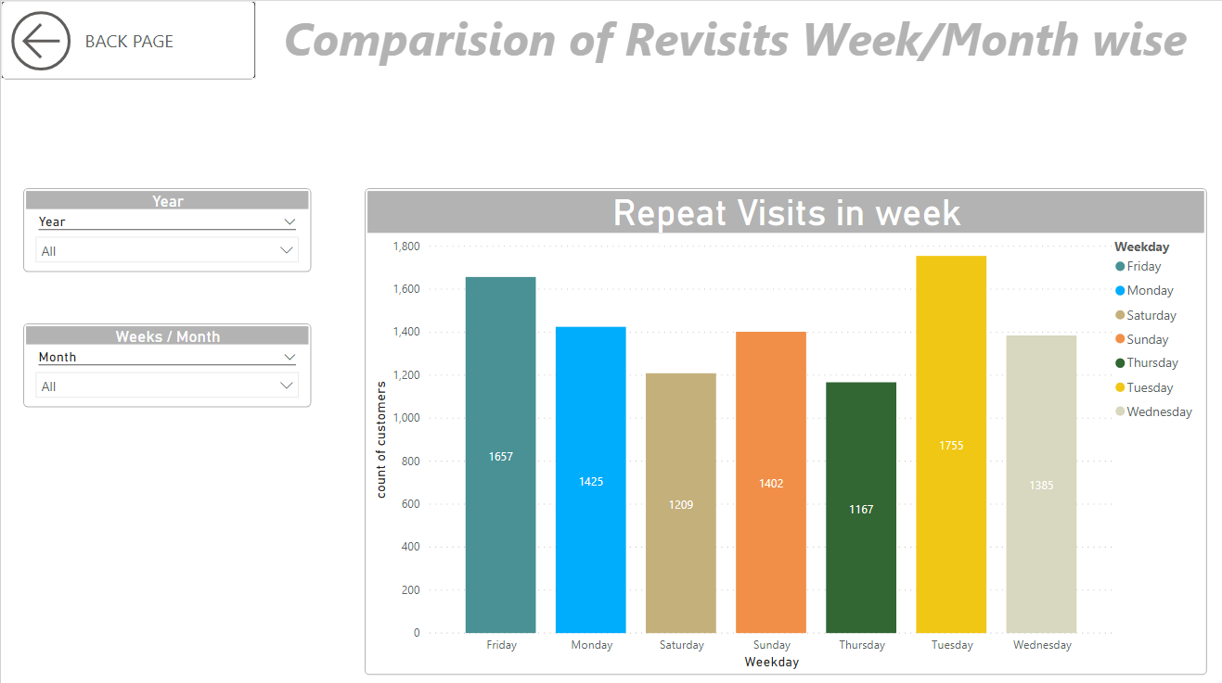
Report

Slide 22
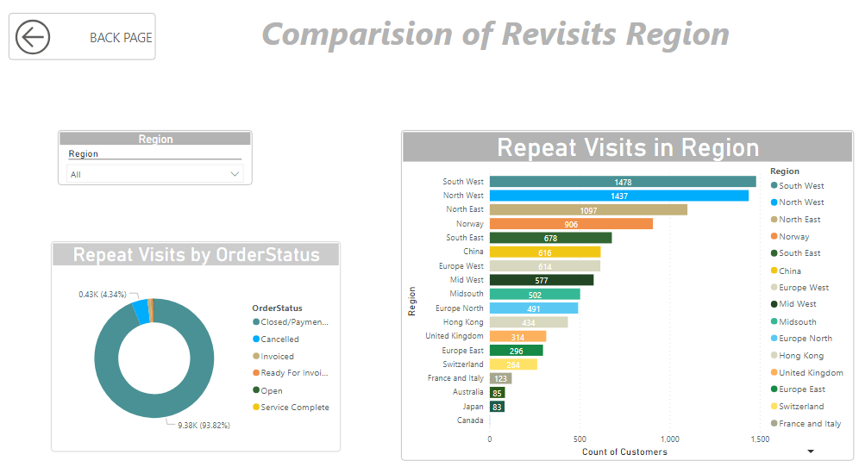
Report

Slide 23
REPORT TESTING

Slide 24
THANKYOU

